Slide 1


Compass Maritime Services LLC : Valuing ships
Aishwarya Reddy Toom
Deepika Burre
Hemachandar Nagarajan
Nishant Anand
Pooja Malviya
Sasidhar Sirivella

Slide 2
About Us
Specialize in the assisting in purchase and sale of ships.
Vessels price valuations
Recycling and Demolition of ships
Objective : Assess the price of a bulk carrier and suggest a bidding price.

Slide 3
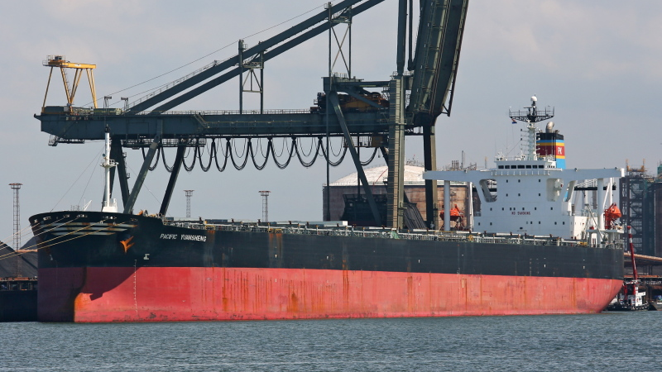
Bet Performer
Age: 11-years (built in 1997 in Japan)
DWT: 172,000 Tonnes
Burmeister & Wain (B&W) 6S70MC engine
Nine holds and hatches
Capesize Index: 12,479 (May 2008)

Slide 4
Ship Valuation
Market Approach – Find price of ship based on comparable recent transactions
Factors
Ship Type (Capesize)
Age
Size ( DWT)
Condition
Other factors: Type of the main engine and its capacity, Reputation of manufacturing company and production quality, Current market & economic conditions.

Slide 5

Which is the best comparable ship ?
In order to find the best comparable ship to the Bet Performer, the following approaches can be used
Ranking Ships
K-nearest neighbors Regression

Slide 6
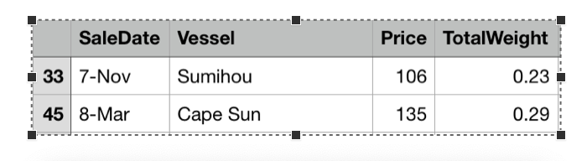
Ranking Approach
Each feature was compared to the respective feature of Bet Performer and the difference was calculated.
The difference calculated for each feature was normalized to a range of 0 to 1.
The normalized difference was multiplied with the correlation between each feature and the price of the ship in order to give more weight to features that were strongly correlated.
The weighted difference for all the features was added together to derive the net weighted difference.
All the ships were sorted based on the net difference and the ships with the lowest net difference were labelled as the closest with respect to the feature of Bet Performer.

Slide 7
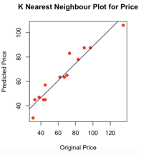
K Nearest Neighbor’s Regression
Regression method used to find the closest comparable ship based on features of Bet Performer
KNN Regression Model
Training Set : 70% of Data Set
Testing Set : 30 % of Data Set
Perfect Prediction ?? Points along y=x line on Predicted Vs Original Price
Most of the testing data set followed the x=y line
Updated the Regression Model to find the nearest ship to Bet Performer
Training Set : 100% of Data Set
Testing Set : Features of Bet Performer i.e. Age, DWT and Capesize

Slide 8
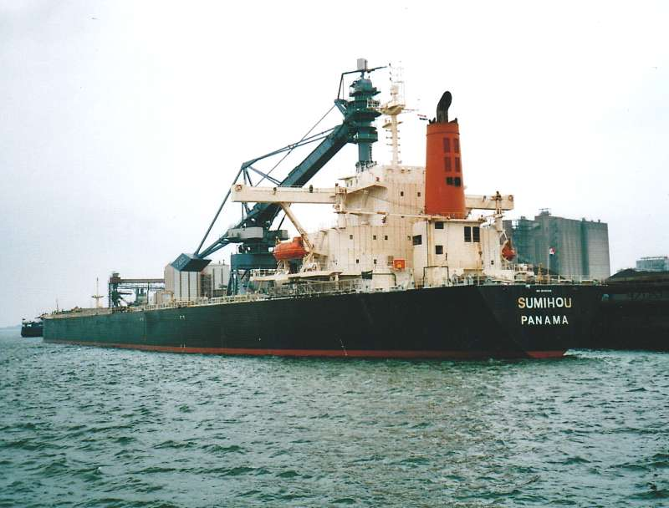
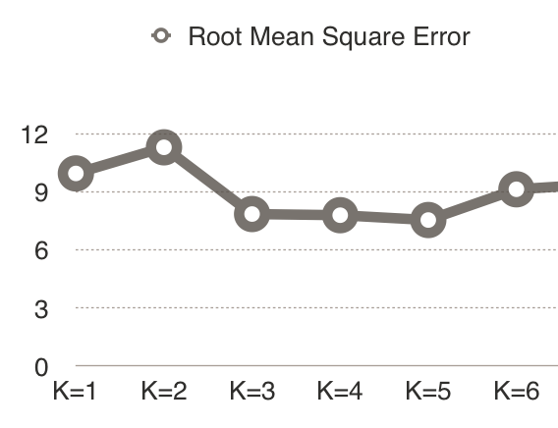
K Nearest Neighbor’s Regression
Which is the nearest neighbour of Bet Performer?
Sumihou with a predicted price of $ 105 M.
How many ships we should consider to predict the price of Bet Performer Accurately?
K=5
Limitations
Consider a small sample size for feature matching

Slide 9
Predicting the price of the ship
To predict the price of the ship we followed a statistical approach called Linear Regression.
There are two ways we used linear regression to predict the price – One variable method and Multi Variable Method.

Slide 10
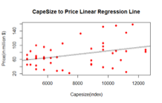
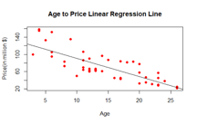
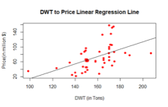
Simple Linear Regression
Age is the best predictor for the price because it is highly correlated with the Sale Price of the ship.
By analyzing the price of the ship against the variables Age at Sale, DWT and Capesize Index we found that
Age at Sale : Ships value depreciates at a rate of around $4.2 million with every year as it ages.
DWT : For every one unit increase in DWT, the price of the ship increases by $0.98 million.
CapeSize : For every one unit increase in CapeSize, the price of the ship increases by $0.004 million.

Slide 11
Linear Regression Estimated Price
Features | Estimated Price
Age at Sale | $86.74 M
Cape Size | $96.06 M
DWT | $85.87 M

Slide 12
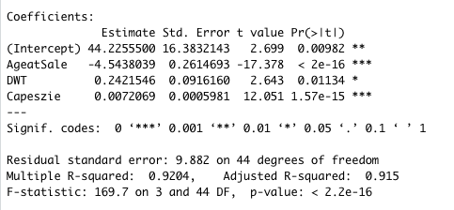
Multiple Linear Regression
With reference to the Regression model, 91.5% of the variation in the sale price of ships could be explained by Age, DWT, and Capesize.
Estimated Price - $125.83 Million

Slide 13
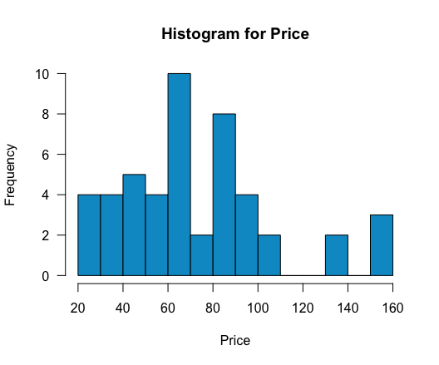
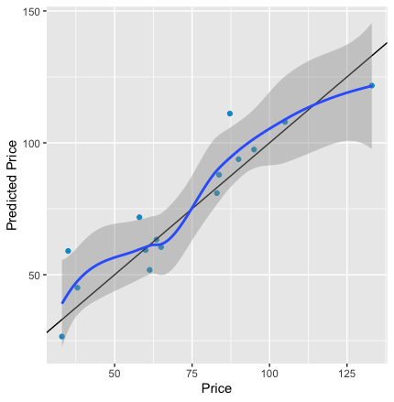
Further Analysis
Bucket 1 : 8 Ships priced above $100 M
Bucket 2 : 40 Ships(13%) priced below $100 M
Confidence Interval : $118M - $132M
Prediction Interval : $104M - $147M
Mean Residual for Bucket 1 : (-ve) 0.8 M
Mean Residual for Bucket 2 : (+ve) 6.36 M

Slide 14
Adjusted Price
Estimated Price - 125.83
Adjusted Price - 125.83 + 6.63

Slide 15
Recommended Price
Our one price offer for the Bet Performer is
$ 132.19 Million

Slide 16
Price Prediction
 | Independent Variables | Predicted Price
5 years younger | Age=6, DWT=172,CapeSize=12479 | $148.54 M
20 k DWT lighter | Age=11,DWT=152,CapeSize=12479 | $120.98 M
30 % Lower charter rate | Age=11,DWT=172,CapeSize=8735 | $98.84 M
If the ship is sold after 3 years | Age=14,DWT=172,CapeSize=12479 | $112.2 M

Slide 17
Economic Factors
Annual cash flow with the current charter rates will be 58 Million USD.
Payback period would be 3-4 years after excluding present average operation, voyage and insurance costs for bulk carriers.

Slide 18
Exit Strategies
As shipping industry is very volatile. We will discuss two exit strategies
Firstly, if the value of the ship increased before maturity it can be sold for a profit and clear principle balance.
On the other hand, if the value of the ship is decreased, 60-80% of the outstanding amount can be cleared by scrapping the ship. In some cases the scrap value of the ship will be higher than the price of the ship in second market.

Slide 19
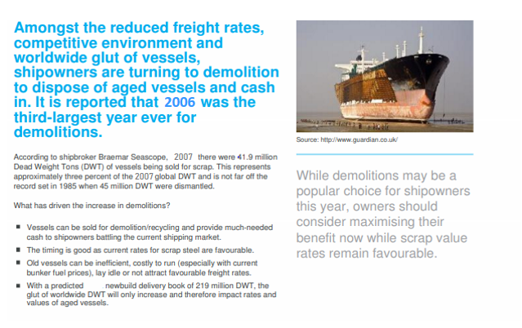

Slide 20
Price Prediction
 | Independent Variables | Predicted Price
5 years younger | Age=6, DWT=172,CapeSize=12479 | $148.54 M
20 k DWT lighter | Age=11,DWT=152,CapeSize=12479 | $120.98 M
30 % Lower charter rate | Age=11,DWT=172,CapeSize=8735 | $98.84 M
If the ship is sold after 3 years | Age=14,DWT=172,CapeSize=12479 | $112.2 M

Slide 21
